Slide 1
Mise en œuvre de Pro Santé Connect avec Microsoft Entra ID
Atelier sur la vérification d’identité à destination des établissements de santé
Version 1.0 (brouillon) – Mai 2025

Slide 2
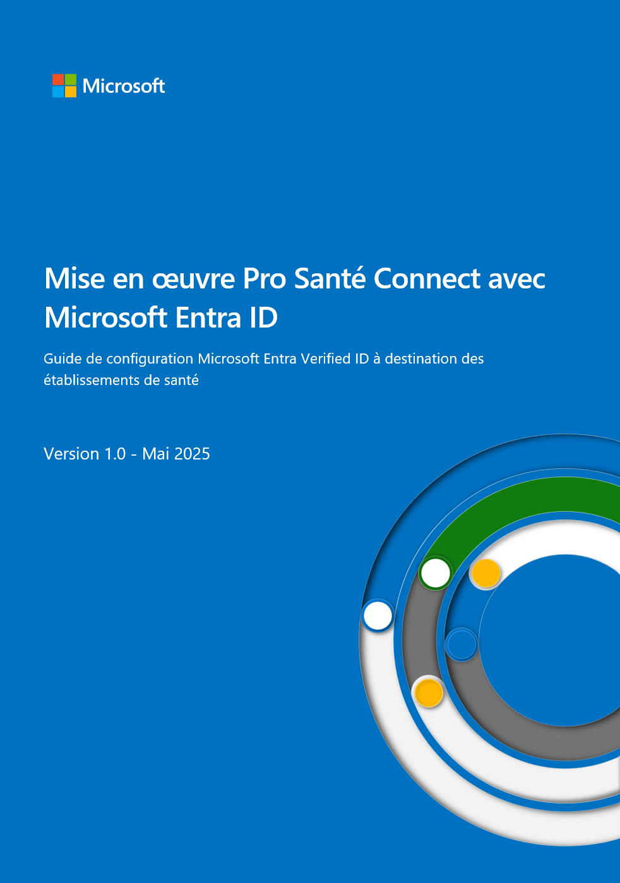
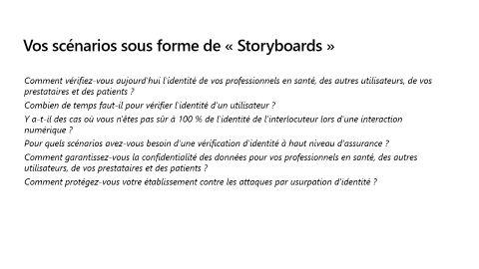
En complément du guide sur la vérification d’identité Bientôt disponible
Pour aller plus loin avec la fondation Entra ID
Locataires Entra concernés pour cet atelier :
Priorité 1 : locataire pour l’intégration applicative de la plateforme PSC avec Entra ID
Priorité 2 : autres locataires
Et à utiliser conjointement
pour vos propres scénarios
https://aka.ms/PSC_VID

Slide 3
Sujets à couvrir pour cet atelier
Introduire la vérification d’identité avec Entra Verified ID
Découvrir les cas d'utilisation les plus courants et les plus importants
Démarrer rapidement, et mettre en œuvre l’API de demande et les exemples GitHub

Slide 4

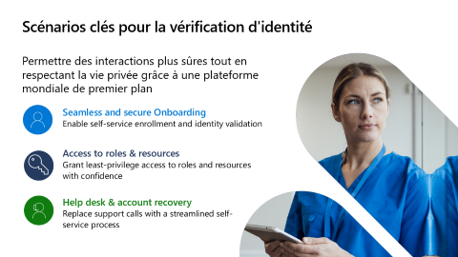
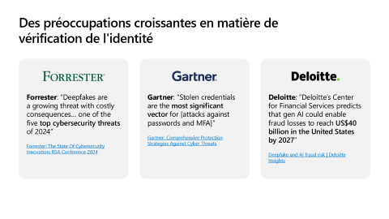
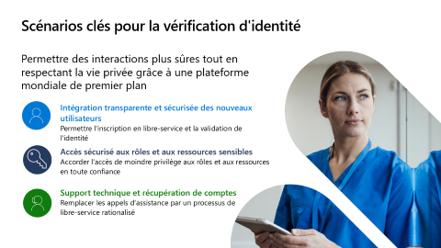

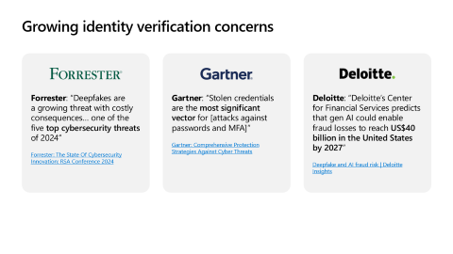
La vérification d’identité avec Entra Verified ID « dans le détail »
Ce qu’il nous parait important de partager :
Introduction à la vérification d’identité avec Entra Verified ID
Scénarios clés pour la vérification d'identité
Intégration transparente et sécurisée des nouveaux utilisateurs
1
2
3

Slide 5
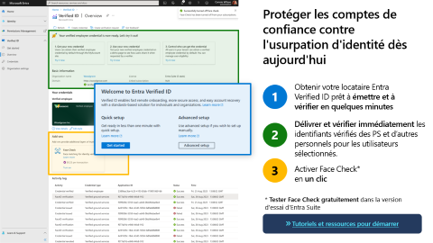



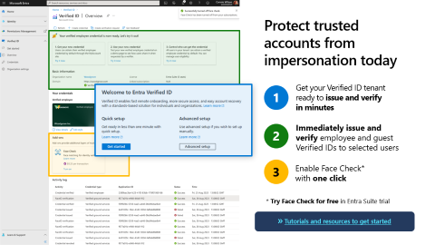

La vérification d’identité avec Entra Verified ID « dans le détail »
Ce qu’il nous parait important de partager :
Accès sécurisé aux rôles et aux ressources sensibles
Support technique et récupération de comptes
Axes de mise en œuvre de la solution et ressources associées
4
5
6

Slide 6

Pour aller plus loin
Consulter la documentation Microsoft pour en savoir plus
Pour en savoir plus
1
En savoir plus sur Face Check avec Microsoft Entra Verified ID
Essayer Microsoft Entra Verified ID gratuitement dans Microsoft Entra ID
2
Blog sur la disponibilité générale de Face Check
Découvrir d'autres cas d'utilisation de Verified ID
Tester Face Check gratuitement dans l'essai gratuit de Microsoft Entra Suite
3
eBook Microsoft Entra Verified ID
En savoir plus sur Microsoft Entra Verified ID
Consulter le dépôt GitHub https://aka.ms/vcsample
Page Web Microsoft Entra Verified ID
4
Fiche technique Microsoft Entra Verified ID
Trouver les outils de développement de Verified ID
Choisir un cas d'utilisation et réaliser un PoC rapide
5
Documentation Microsoft Entra Verified ID

Slide 7
Merci !

Slide 9



Des préoccupations croissantes en matière de vérification de l'identité
Forrester: “Deepfakes are a growing threat with costly consequences… one of the five top cybersecurity threats of 2024”
Forrester: The State Of Cybersecurity Innovation: RSA Conference 2024
Gartner: “Stolen credentials are the most significant vector for [attacks against passwords and MFA]”
Gartner: Comprehensive Protection Strategies Against Cyber Threats
Deloitte: “Deloitte’s Center for Financial Services predicts that gen AI could enable fraud losses to reach US$40 billion in the United States by 2027”
Deepfake and AI fraud risk | Deloitte Insights
Notes:
Identity verification is becoming more important as work and life shifts more online. Digital identities are how people interact with the world today, both in work and personal life. Hackers understand this and are looking to take advantage of it by targeting identity more frequently and with more advanced methods such as deepfakes and other forms of impersonation powered by generative AI. Analysts understand these shifts and are giving us warnings.
TRANSITION: What are some specific areas where identify verification is especially needed?

Slide 10
Interactions clés nécessitant une confiance et une efficacité accrues
81 %
des nouveaux utilisateurs se sentent dépassés par l’intégration
75 %
des données personnelles de la population mondiale seront soumises à une réglementation en matière de protection de la vie privée d'ici à la fin 2025
1,1 milliard de dollars
perdus à cause d'escroqueries à l'usurpation d'identité aux États-Unis en 2023
Lacunes de l’intégration
Défis en matière d'accès
Vulnérabilités du support technique
Forbes: Why Better Onboarding Is Key To Improved Productivity
Gartner 2024 Top Five Trends in Privacy
FTC Data Spotlight into impersonation scams
Quel est l'impact ?
Importance croissante de savoir qui a accès à vos ressources et de lui faire confiance
Suppression nécessaire des voies potentielles d'usurpation d'identité
Perte de temps et de productivité
Notes:
Key interactions that every organization have on a regular basis are lacking in trust & efficiency
Heightened the importance of managing online identities efficiently while providing a simple user experience and protection for identities and personal information.
There’s a growing risk of impersonation and account takeover. Bad actors use insecure credentials in 66% of attack paths. For example, impersonators may use a compromised password to fraudulently log in to a system. With advancements in generative AI, complex impersonation tactics such as deepfakes are growing as well. Many organizations regularly onboard new employees remotely and offer a remote help desk. Without strong identity verification, how can organizations know who is on the other side of these digital interactions? Impersonators can easily bypass common verification methods such as counting bicycles on a CAPTCHA or asking which street you grew up on. As fraud skyrockets for businesses and consumers, and impersonation tactics have become increasingly complex, identity verification has never been more important.
Many organizations today are hampered with inefficiencies and extra costs due to the strain of identity management processes and identity verification. They are managing the personal data for their employees, customers, and guests. This practice is not sustainable and unnecessarily adds to the burden of identity management
The current status quo is not sustainable for the digital future. Organizations will have to find a better way to manage their user’s identities, or they will continue to leave themselves bogged down in managing inefficient identification processes as well as more vulnerable to impersonation attacks.
Key challenges
Onboarding
¹ ***lots of great stats to look at from the source: https://www.g2.com/articles/onboarding-statistics***
88% of workers think their company’s onboarding has room for improvement
Great onboarding can improve retention by 82% and work quality by over 70%
Onboarding is biggest challenge for 37.4% of HR professionals
47% of businesses face difficulties in onboarding due to problems with accessing infrastructure.
22% employee turnover without efficient onboarding within the first 45 days of employment.
Access Challenges
Regulation over data and access is growing: 75% of global population’s personal data will be under privacy regulation by year-end 2024 according to Gartner².
Imperative to know who has access to your resources and trust them, strict compliance requirements in place for regulated industries and government vendors. Hefty financial penalties for noncompliance, many industries have complex privacy and identity related regulations to mange. Some examples include:
FinServ: Know your customer (KYC) and anti-money laundering (AML)
Healthcare: patient privacy laws such as HIPPA in the U.S.
Edu: student privacy protection laws such as FERPA in the U.S.
Example: Access to resources without verification creates risks: In 2023, an attacker got into T-Mobile through a single improperly secured API. Result was a data breach that affected approx. 37M customer accounts^{3,4}. Likely could have been avoided if they had proper ID verification before granting access
Help desk vulnerability
330K+ reports of business impersonation scams, Over $1.1B loses to impersonation scams of all types in US in 2023⁸ and 35% of business in the UK experienced an impersonation attack over the last 12 months^{9.}
Impersonators often get in by posing as employees, calling the help desk, and getting their device registered to the employee’s account.
Example: Happened to MGM in 2023, impersonator had a 10 min call with the help desk, was given access to MGM internal systems, and did damage forced MGM to shut down all systems and lost 100M in total^{7,10}
Hackers are getting smarter with impersonation and social engineering
Evolved phishing considered top threat for CIOs by Gartner⁵: vishing (voice), smishing (text, social media, collaboration platforms). Phishing leads to credential theft and data exfiltration. Phishing is a top contributor to data loss
Credential abuse: attacker logs in as someone with legitimate access, can sometimes defeat MFA which remains a best practice for authentication if using modern methods and flows
Deepfakes considered a top five cybersecurity threat of 2024 by Forrester⁶. The rise of deepfakes and other gen-AI impersonation tactics creates new security vulnerabilities that are growing in frequency.
----------------------------------------------
Sources
¹50+ Employee Onboarding Statistics You Must Know in 2024 (g2.com): https://www.g2.com/articles/onboarding-statistics
²Gartner 2024 Top Five Trends in Privacy: https://www.gartner.com/en/newsroom/press-releases/2022-05-31-gartner-identifies-top-five-trends-in-privacy-through-2024
³T-Mobile Informing Impacted Customers about Unauthorized Activity - T-Mobile Newsroom: https://www.t-mobile.com/news/business/customer-information
⁴T-Mobile breached by hackers as 37 million customers impacted - ABC News (go.com): https://abcnews.go.com/US/mobile-breached-hackers-37-million-customers-impacted/story?id=96557559
⁵Comprehensive Protection Strategies Against Cyber Threats | Gartner: Comprehensive Protection Strategies Against Cyber Threats | Gartner
⁶Forrester State of Cybersecurity Innovations: https://www.forrester.com/blogs/state-of-cybersecurity-innovation-rsa-conference-2024/#:~:text=Forrester%20calls%20out%20deepfakes%20as%20one%20of%20the,and%20brand%20damage%2C%20amplification%20of%20misinformation%2C%20and%20more.
⁷Inside The Ransomware Attack That Shut Down MGM Resorts (forbes.com): https://www.forbes.com/sites/suzannerowankelleher/2023/09/13/ransomware-attack-mgm-resorts/
⁸Federal Trade Commission Research: https://www.ftc.gov/business-guidance/blog/2024/04/new-ftc-data-spotlight-offers-illuminating-insights-impersonation-scams
⁹uk.gov research: https://www.gov.uk/government/statistics/cyber-security-breaches-survey-2024/cyber-security-breaches-survey-2024
¹⁰MGM loses $100M, refused to pay ransom to end cyberattack (nypost.com) MGM loses $100M, refused to pay ransom to end cyberattack (nypost.com)

Slide 11
Instaurer la confiance et l'efficacité avec Microsoft Entra Verified ID
Onboard workers securely in minutes, not days or weeks
Adhere to privacy regulations by allowing resource access only for trusted users
Simplify help desk & account recovery for trusted users, while blocking impersonators
Trustworthy remote onboarding
Secure access to resources
Help Desk & Account Recovery
Defend against impersonation with Face Check
Ensure the right person onboards
Limit impersonation of trusted accounts
Prevent fraudulent help desk access
Notes:
How can Microsoft help you address these issues?
Introduce Verified ID in all these processes to improve trust & efficiency
Microsoft Entra Verified ID is a managed verifiable credential service that lets organizations build unique user-owned identity scenarios designed for trustworthy, secure, and efficient interactions between people and organizations.
Face Check with Microsoft Entra Verified ID introduces privacy-respecting facial matching into your identity verification processes. It unlocks a secure, compliant way to perform high-assurance identity verification at scale – all in a user-friendly flow. Designed to combat spoofing such as deepfakes or using a still image to impersonate someone.
Problem: 88% of workers think their company’s onboarding could be improved
Solution: Trustworthy remote onboarding
Establish quick, self-service onboarding
Validate identity information with ID verification partners
Use Face Check to ensure the right person is onboarding
Problem: Privacy regulations are becoming more frequent and complex
Solution: Secure access to your organization’s resources
Allow access only to trusted users
Adhere to privacy regulations more easily by ensuring that malicious actors don’t have access
Use Face Check to ensure the right people have access without needing manual approval from admins or managers
Problem: Help desks are vulnerable and easily infiltrated by impersonators
Solution: Introduce verifiability and self-service options into your help desk
Verify who is calling the help desk to prevent attacks like the one discussed on the previous slide
Reduce support phone calls and security questions and create self-service help desk and account recovery flow options
Use Face Check to ensure the right person is accessing the help desk
By using Verified in a well-structured onboarding program, businesses can significantly reduce turnover costs, boost productivity, and ultimately drive organizational success.
Many organizations today are hampered with inefficiencies and extra costs due to the strain of suboptimal identity management processes and identity verification. They are managing the personal data for their employees, customers, and guests. This practice is not sustainable and unnecessarily adds to the burden of identity management
Key challenges
Remote onboarding¹ ***lots of great stats to look at from the source: https://www.g2.com/articles/onboarding-statistics***
88% of workers think their company’s onboarding has room for improvement
Great onboarding can improve retention by 82% and work quality by over 70%
Onboarding is biggest challenge for 37.4% of HR professionals
47% of businesses face difficulties in onboarding due to problems with accessing infrastructure.
22% employee turnover without efficient onboarding within the first 45 days of employment.
Access Challenges
Regulation over data and access is growing: 75% of global population’s personal data will be under privacy regulation by year-end 2024 according to Gartner².
Imperative to know who has access to your resources and trust them, strict compliance requirements in place for regulated industries and government vendors. Hefty financial penalties for noncompliance, many industries have complex privacy and identity related regulations to mange. Some examples include:
FinServ: Know your customer (KYC) and anti-money laundering (AML)
Healthcare: patient privacy laws such as HIPPA in the U.S.
Edu: student privacy protection laws such as FERPA in the U.S.
Example: Access to resources without verification creates risks: In 2023, an attacker got into T-Mobile through a single improperly secured API. Result was a data breach that affected approx. 37M customer accounts^{3,4}. Likely could have been avoided if they had proper ID verification before granting access
Help desk vulnerability
330K+ reports of business impersonation scams, Over $1.1B loses to impersonation scams of all types in US in 2023⁸ and 35% of business in the UK experienced an impersonation attack over the last 12 months^{9.}
Impersonators often get in by posing as employees, calling the help desk, and getting their device registered to the employee’s account.
Example: Happened to MGM in 2023, impersonator had a 10 min call with the help desk, was given access to MGM internal systems, and did damage forced MGM to shut down all systems and lost 100M in total^{7,10}
Hackers are getting smarter with impersonation and social engineering
Evolved phishing considered top threat for CIOs by Gartner⁵: vishing (voice), smishing (text, social media, collaboration platforms). Phishing leads to credential theft and data exfiltration. Phishing is a top contributor to data loss
Credential abuse: attacker logs in as someone with legitimate access, can sometimes defeat MFA which remains a best practice for authentication if using modern methods and flows
Deepfakes considered a top five cybersecurity threat of 2024 by Forrester⁶. The rise of deepfakes and other gen-AI impersonation tactics creates new security vulnerabilities that are growing in frequency.
Conclusion
The current status quo is not sustainable for the digital future. Organizations will have to find a better way to manage their user’s identities, or they will continue to leave themselves bogged down in managing inefficient identification processes as well as more vulnerable to impersonation attacks.
----------------------------------------------
Sources
¹50+ Employee Onboarding Statistics You Must Know in 2024 (g2.com): https://www.g2.com/articles/onboarding-statistics
²Gartner 2024 Top Five Trends in Privacy: https://www.gartner.com/en/newsroom/press-releases/2022-05-31-gartner-identifies-top-five-trends-in-privacy-through-2024
³T-Mobile Informing Impacted Customers about Unauthorized Activity - T-Mobile Newsroom: https://www.t-mobile.com/news/business/customer-information
⁴T-Mobile breached by hackers as 37 million customers impacted - ABC News (go.com): https://abcnews.go.com/US/mobile-breached-hackers-37-million-customers-impacted/story?id=96557559
⁵Comprehensive Protection Strategies Against Cyber Threats | Gartner: Comprehensive Protection Strategies Against Cyber Threats | Gartner
⁶Forrester State of Cybersecurity Innovations: https://www.forrester.com/blogs/state-of-cybersecurity-innovation-rsa-conference-2024/#:~:text=Forrester%20calls%20out%20deepfakes%20as%20one%20of%20the,and%20brand%20damage%2C%20amplification%20of%20misinformation%2C%20and%20more.
⁷Inside The Ransomware Attack That Shut Down MGM Resorts (forbes.com): https://www.forbes.com/sites/suzannerowankelleher/2023/09/13/ransomware-attack-mgm-resorts/
⁸Federal Trade Commission Research: https://www.ftc.gov/business-guidance/blog/2024/04/new-ftc-data-spotlight-offers-illuminating-insights-impersonation-scams
⁹uk.gov research: https://www.gov.uk/government/statistics/cyber-security-breaches-survey-2024/cyber-security-breaches-survey-2024
¹⁰MGM loses $100M, refused to pay ransom to end cyberattack (nypost.com) MGM loses $100M, refused to pay ransom to end cyberattack (nypost.com)

Slide 12
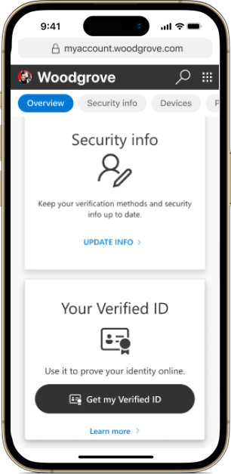
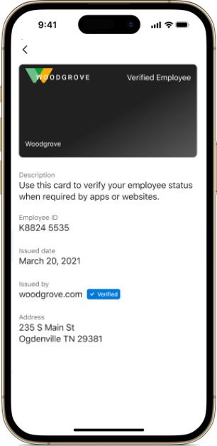
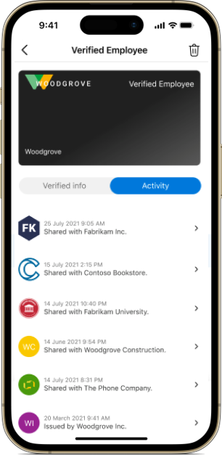
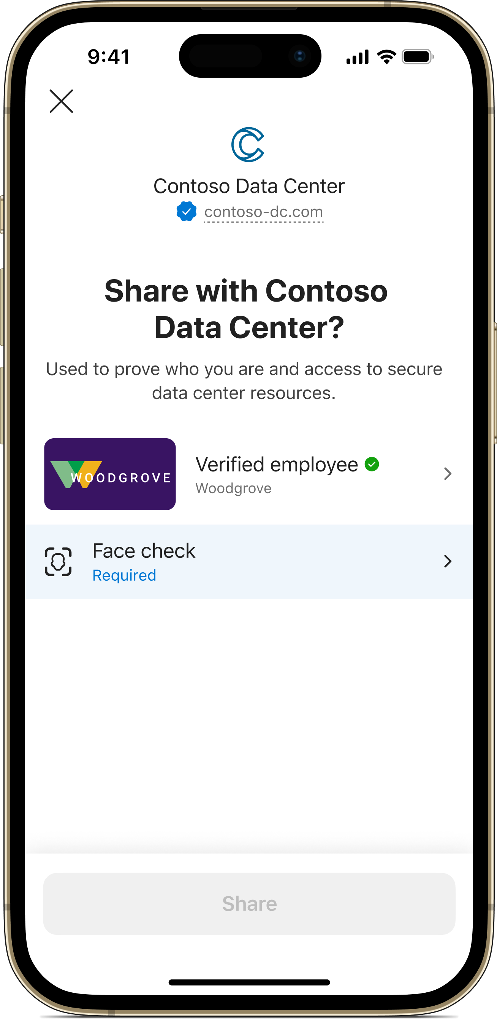
Introduce trust & efficiency with Microsoft Entra Verified ID 2
Issue easily Create and distribute Verified IDs that affirm identity attributes for users
Use anywhere Users own Verified IDs in a digital wallet, see the attributes contained, and can share them with any organization
Verify confidently Request users to share a Verified ID to verify identity attributes and establish trust
Notes:
What is a Verified ID?
A card a user keeps in their digital wallet on their personal device that attests to an identity attribute. Having a Verified ID means that a trusted authority is confirming an identity attribute about the user.
Issue easily
Organizations that are trusted authorities (employer, university, government, trusted partner, etc.) create Verified IDs that confirm something about someone’s identity (who they are, their nationality, employment status, age, training/skills, permissions, another identity attribute, or multiple attributes) and distribute them to users (employees, students, citizens, consumers, etc.)
Use anywhere
Verified IDs are user owned credentials. They are stored on a digital wallet, could be Microsoft Authenticator app or a branded app. Users can see the identity attributes stored on the Verified ID. Users can use a single Verified ID for many verifications
Verify confidently
Organizations can ask users to share their Verified ID to develop trust that the person they are interacting with is who they think it is.
Issue easily
Users must request a Verified ID from an organization, usually by scanning a QR code that takes the user to an identity validation process. Employees, partners and customers that go through the organization’s process to validate their identity will be issued a Verified ID. Examples of what identity claims an organization could validate: name/identity, age, nationality, employer/employment status, a particular skill or licensure, student or alumni status, etc. Users can start the process of being issued a Verified ID with a simple QR code scan.

Slide 13

How Entra Verified ID works
1
Request Verified ID
3
Request access
Issuer
User
Verifier
Verifier initiates verification challenge
2
Issue credential
4
Proof of identity
Owns and manages Verified IDs
Can use one Verified ID for many verifications
Before issuing a Verified ID, issuers attest to identity claims of any type
iss: did:example:woodgrove sub: did:example:user claims:
title: program manager
since: 2011
+ issuer’s digital signature
iss: did:example:woodgrove sub: did:example:user claims:
title: program manager
since: 2011
+ issuer’s digital signature
+ subject’s digital signature
After identity verification, verifiers approve user access to protected assets or operations
Identifiers
Documents
Certifications
5
Grant user access
Resources
Workflows
Actions
Record public key material
Lookup public key material
iss: did:example:123 keys: "------BEGIN PUBLIC KEY --…"
Trust System
Notes:
Verified ID begins and ends with the individual Verified ID holder. They own and manage their Verified IDs and store them in a digital wallet on their personal device. They can see what identity claims or information are on a Verified ID, so they know what data they are sharing when they present their Verified ID. Examples of identity claims on a Verified ID could be information as simple as one’s name, age, or date of birth. Other examples could be their employment status, whether they’ve completed a certain training or certification, nationality, or any other claim. Also, they are not forced to share the Verified ID, they choose to share when they need to prove their identity.
How does a holder get a Verified ID in the first place? Let’s look at the process on the left side of the graphic
Step1
First the user requests a Verified ID from an issuer. Issuers are organizations that can attest to identity claims. An identity claim is any type of info that could be stored on a Verified ID (name, job role, age, etc.).
Examples:
An employer attesting that a new hire is an employee before giving them an employee credential. Employer is issuer, new hire being an employee of that company is the claim.
After graduating, a student’s university can attest that they graduated and give them a digital diploma credential. University is issuer, graduating to alumni status is the claim
A government could attest that someone is a citizen before giving a digital ID or passport. Government is the issuer, citizenship status is the claim. Age on the ID or passport could be another claim
Credentials including these and many other types could be made digital as Verified IDs.
After the user requests a Verified ID, the issuer responds by asking the holder to complete an identity attestation process. All this means is that the issuer wants to be sure about the individual’s identity before giving them a credential. Maybe an organization wants to see a passport or driver’s license to prove their identity. Another example could be passing an exam before being granted a professional certification.
Step2
Once the issuer is satisfied that they are sure of the individual user’s identity claim, they issue the Verified ID to the individual that attests to that identity claim. Holders only go through the identity attestation process once and then are given a Verified ID that they can use repeatedly, eliminating the cost and time taken to reverify frequently
Step3
Now that the holder has a Verified ID, they will use it to request approval to access something from a verifier.
Step4
The holder requests access from a verifier. A verifier is an organization that checks identity claims before granting an individual access approval to a protected resource the holder use, workflow they could join, or action they could take.
Examples:
A bank wants to see proof of employment before letting a customer open an account.
An employer might want to see a university diploma before giving someone a job.
Sometimes the issuer and verifier in a single interaction can be the same organization. If someone’s employer gave them an employee credential, that same employer may want to prove an individual’s employment status before letting them reset their account password or accessing the helpdesk.
Proof of employment and a diploma are just two examples of digital credentials that could be expressed in a Verified ID.
After the holder requests access to a resource, the verifier responds with an identity challenge. Usually this is a QR code that the holder will scan and then they will be prompted to present their Verified ID within the Microsoft Authenticator app, where Verified IDs are stored. This is where the holder decides whether or not they want to share their Verified ID. If the holder shares their Verified ID with the verifier, the identification process takes only a few seconds, and then the verifier can be confident in knowing who they are granting access to.
Step5
When the holder presents their valid Verified ID, the verifier (Fabriikam) will verify the “Verified ID” presented, and then grant the holder access to the resource in question.

Slide 14


Based on open standards (details: http://aka.ms/vcinterop )
People, Apps, and Devices
Open ID Connect SIOP
Open ID Foundation
User Agent
Stage: Working Implementations
Users
Universal Resolver
Stage: Working Implementations
W3C Verifiable Credentials
Stage: Published Standard
Trusted Systems
W3C Decentralized Identifiers
did://
Stage: Recommended Standard
Join, Collaborate, Contribute
CCG
Notes:
Microsoft is actively collaborating with members of the Decentralized Identity Foundation (DIF), the W3C Credentials Community Group, and the wider identity community. We’re working with these groups to identify and develop critical standards, and we've implemented the open standards in our services.
Our collaboration efforts aim to build a Verifiable Credentials Interoperability profile to support standards-based issuance, revocation, presentation, and wallet portability.
Today, we have a working JWT verifiable credentials presentation profile that supports the interoperable presentation of verifiable credentials between wallets and verifiers/resource providers. Join us at the DIF Claims and Credentials working group, aka.ms/vcinterop.

Slide 15
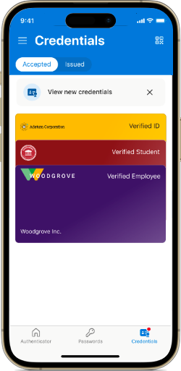
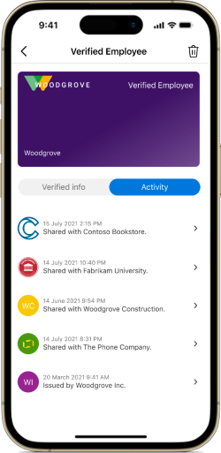
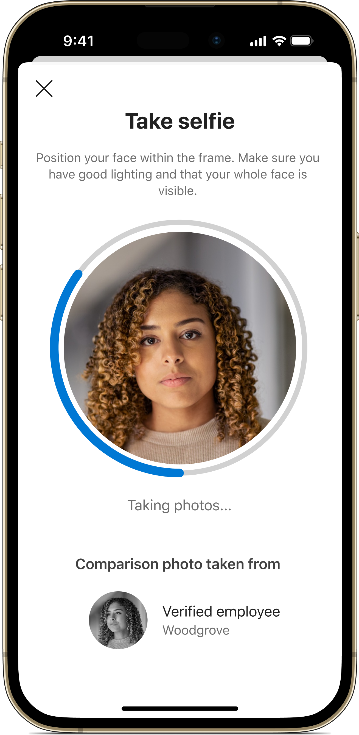
Verified ID user lifecycle 2
Issuance
Management
Verification
Admin revokes credential
Credential expiration date passes
User deletes credential
End of life options
Notes:
Issuance from MyAccount or custom site
User owns credentials in wallet, can view activity for each owned verified id in a timeline view in the authenticator app or custom wallet
User shares credentials with orgs for verification
End of life, 3 options
- A user may leave a job, a project might be finished, many reasons for a credential to expire
- Admin can set expiry date for VC, so it has either to be re-issued or expires if not re-issued. (only custom credential, Verified Employee has always 6 months)
- If a credential expires or is revoked, it will no longer be valid to use if admin revokes it, even if user does not delete credential,

Slide 16













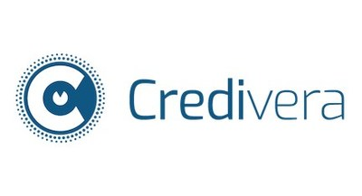




Jumpstart with partners
192
Countries
Leading identity verification partners
6000
Identification documents
1000’s
Organizational attributes
…and growing!
Millions
Individual ID attributes
Accelerate adoption with a growing ecosystem of partner solutions
Decades
of experience to go from idea to implementation in hours
…and growing!
Notes:
One way explore the possibilities and to get started with Face Check with Microsoft Entra Verified ID is to work with a partner. The right partner can help you set up a particular type of identity verification, help you implement Verified ID into your existing apps and resources, or help you craft your Verified ID scenario to handle a specific challenge.
So, you should have a good overview of what scenarios Verified ID can be used in and maybe you already have a scenario in mind which would work well for your own organization.
We have a large partner network which extends and accelerates Microsoft Entra Verified ID adoption. It’s a growing partner gallery and we have both Identity verification and services partner in this list.
Identity verification partners (IDVs) help you build seamless identity proofing and verification experiences in your line of business apps - IDV partner gallery is available at https://aka.ms/verifiedidisv
Service partners offer advisory, implementation, integration and managed service capabilities that can help you build seamless end-user experiences using Verified ID.
TRANSITION: Now that you know about the possibilities, let’s see pricing

Slide 17
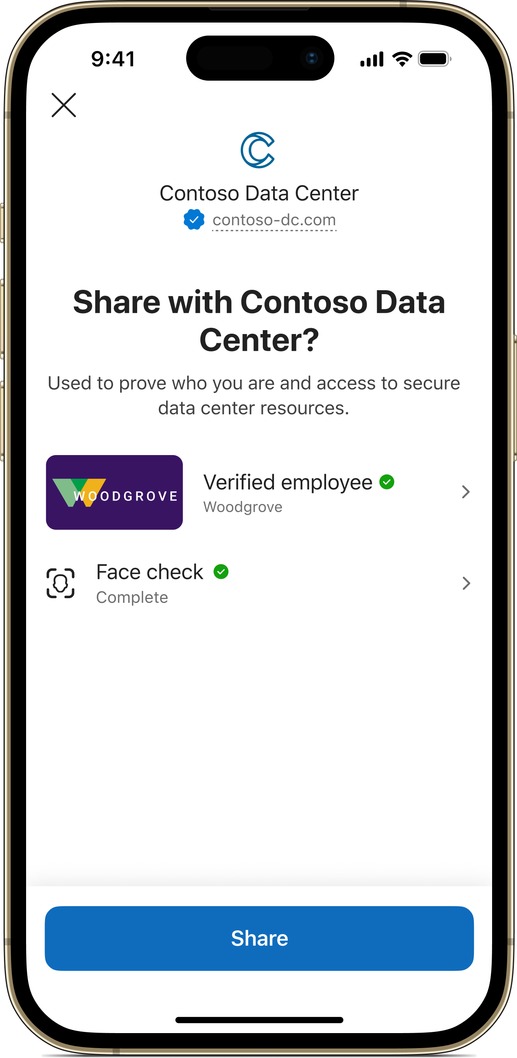
Grant access to only the right people with Face Check
High-assurance verification at scale
Build on trust established with Verified ID with an added layer of identity verification
Verify liveness in an instant
Make sure the right person is using a Verified ID in real time, while respecting their privacy
Facial matching in any scenario
High assurance for onboarding, account recovery, or any Verified ID scenario
Present Verified ID and start Face Check
Take selfie for Face Check
Share valid Verified ID and Face Check for verification
Notes:
Face Check with Microsoft Entra Verified ID introduces privacy-respecting facial matching into your identity verification processes. Use it to be certain that you know who is on the other side of a digital interaction when they present a Verified ID.
Face Check is a premium add on that you can implement on top of Verified ID for an additional verification layer of liveness. Know who is presenting a Verified ID in the moment it is presented. All it takes is a quick selfie.
Face Check can be added to any Verified ID scenario. Stop impersonators from onboarding to your company, accessing your sensitive resources and apps, and from using the help desk as an entrance into your organization.
How does Face Check with Microsoft Entra Verified ID work? (left side of screen)
Users own Verified IDs, which contain information about their identity such as their name, age, employment status, nationality or any other identity. The Verified ID can store a picture, usually one that comes from a trusted document such as a passport, driver’s license, or employee credential.
Face Check compares an individual’s live selfie with the photo that is stored on their Verified ID.
Face Check is privacy-respecting, it does not pass or store any personal information after completing the Face Check. The live selfie is discarded, and the verifying organization only receives a confidence score that shows how closely the live selfie and stored Verified ID photo resemble each other. Verifiers set a threshold confidence score that they will deem as a valid score. Default is 75%
Examples where you may want Face Check in addition to Verified ID:
For a basic help desk function, just Verified ID is likely enough. If an employee wants to reset their password or recover their account, those are more sensitive actions where you might want to be more certain about who is taking the action. Use Face Check to ensure that the rightful user is taking this action and that an impersonator isn’t going to lock them out by changing a password
If a banking customer is making an unusually large transaction, you may want to make sure the right person is spending that much money
In academia, a university could want to make sure that the right student is about to take an online exam
Use Face Check for an action in need of higher assurance that you’re dealing with the right person
TRANSITION: Let’s see an example

Slide 18

Face Check Powered by Azure AI Vision API
User centric liveness match
Verifies that it is a real person in the live footage
Only a confidence in match is shared with the app
Match performed within the Verification App’s cloud data boundary
Azure AI Version service can detect a wide variety of spoofing techniques and conformant to ISO/IEC 30107-3 PAD (Presentation Attack Detection) standards as validated by iBeta level 1 and level 2 conformance testing

Slide 19
Licensing
Capabilities
Included in Microsoft Entra ID Free
Included in Microsoft Entra ID P1
Included in Microsoft Entra Suite
Anyone can issue/verify
(up to 50k monthly active users)
Unlimited Credentials
Face Check
**
Add-on *
Integration with Microsoft Entra ID Governance entitlement management
* $0.25 per verification if purchasing standalone
** 8 Face Checks per user per month included in Entra Suite, $0.25 each for additional verification
Notes:
There are many ways to start using Verified ID depending on which scenario you want to use it for.
Can start using Verified ID with baseline credential issuance and verification capabilities for free up to 50k MAU. For over 50k MAU, Verified ID is included with Entra ID P1 or P2. This covers almost any use case with basic issuance and verification of credentials.
Face Check costs $0.25 per verification. If you purchase an Entra Suite license, 8 Face Checks per user per month are included in that price. If you use more than 8 PUPM, the standalone price kicks in for the additional verifications. The Face Checks are not tied to a specific user, they are pooled. Entra Suite license is $12 per use per month, but there is a free trial.
To unlock the integration of Verified ID and entitlement management in ID governance, you will need an ID governance license. ID governance is included in the Entra Suite as well as Face Check with Verified ID. It is also sold separately at $7 PUPM standalone. For more pricing details: https://www.microsoft.com/en-us/security/business/microsoft-entra-pricing#x9e9538c905ad47cfbdc6cf196d5eabf4
TRANSITION: Now you know the basics, let’s talk about how to apply Verified ID to your organization

Slide 20

Scénarios clés pour la vérification d'identité
Permettre des interactions plus sûres tout en respectant la vie privée grâce à une plateforme mondiale de premier plan
Intégration transparente et sécurisée des nouveaux utilisateurs
Permettre l'inscription en libre-service et la validation de l'identité
Accès sécurisé aux rôles et aux ressources sensibles
Accorder l'accès de moindre privilège aux rôles et aux ressources en toute confiance
Support technique et récupération de comptes
Remplacer les appels d'assistance par un processus de libre-service rationalisé
Notes:
What are common areas where you can use Verified ID and Face Check? Verified ID has been generally available for about two years, and these are the three most common scenarios we have seen. Let’s go through some details of each:
Onboarding which can help enable self-service enrollments and provide identity verification for employees, workers, contractors, consumers etc and support KYC journeys
Access to roles and resources which help to grant access with confidence
Helpdesk and account recovery, which can help replace support calls by having a streamlined self-service process. This is the one from the demo

Slide 21
La vérification d’identité au service de la santé
Medical & insurance fraud
Regulatory compliance: HIPPA, GDPR
Accurate patient identification
Digital transformation in managing healthcare data and personnel
Protecting & managing access to medical records, clinical trials, and research
Notes:
Medical & insurance fraud: make sure the right people are getting treatment and that someone isn’t impersonating a patient for monetary gain through insurance, getting other people’s prescriptions
Accurate patient identification: Misidentification can happen accidentally due to similar patient names, inaccurate or incomplete info, human error, etc. Minimize this by properly identifying patients
Protecting access to medical records: patients and medical professionals should be able to access the right data easily, but that data also needs to be protected from unauthorized access. How do healthcare providers make sure that only the right people have access?
Regulatory compliance: Protecting patient data while ensuring compliance with regulations like HIPAA and GDPR is a major concern
Digital transformation: streamlining and introducing verification into legacy systems, medical systems and their IT infrastructure can be complex and unwieldy. Introducing proper identity verification into these processes can save costs and time

Slide 22
La vérification d’identité au service de la santé
Patient verification during registration & check-in
Distributing prescription medications
Verified help desk for billing, insurance, app support, etc.
Patient verification for telehealth appointments
Access to electronic health records
Ensure only legitimate patients can recover healthcare or insurance accounts
Issue digital insurance cards
Streamline transfers of healthcare personnel
Issue Verified IDs to healthcare workers for certifications or licenses
Secure access to clinical trial & research findings
Et bien d'autres applications encore…
Notes:
Onboarding
Patient registration & check-in: better patient identification, reduce medical identity theft, insurance fraud, and misidentifying patients both in person and in telehealth appointments
Make sure you’re working with the right patient in telehealth
Digital insurance cards: be able to verify legitimate customers to limit insurance fraud
Certifications/licenses for healthcare workers: attest to the skills of healthcare workers, easily verify their skills later
Access
Make sure you give prescription meds to the right patient by checking a patient or insurance Verified ID
Only allow the right patient access to medical records
Limit administrative work, make it easier for healthcare workers to transfer between different hospitals (NHS case study on next slide)
When sharing sensitive information across organizations during clinical trials or research, make sure that only the right people have access and can do so easily
Helpdesk & acct recovery
Use a verified help desk for support with medical billing, insurance, app support, etc
Limit fraud by making sure only the right patients can recover their accounts

Slide 23

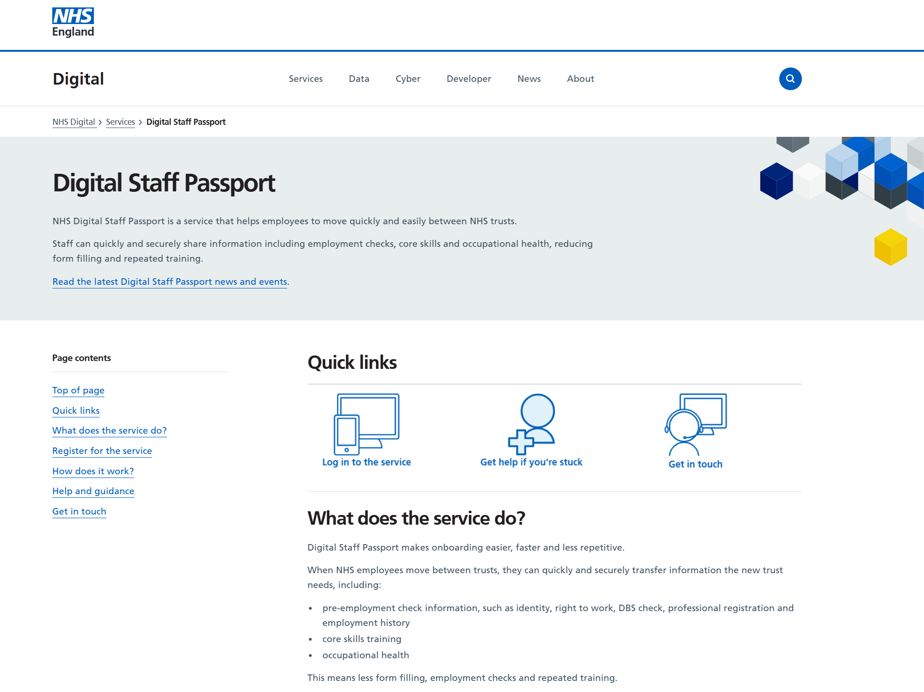
National Health Service (NHS)
Problème
Difficulté à déplacer rapidement les prestataires de soins de santé entre plus de 200 établissements hospitaliers
Traitement des tâches administratives pouvant prendre plusieurs jours
Aucun moyen simple pour les prestataires de soins de santé de présenter leurs licences et certifications
Solution
Digital Staff Passport pour favoriser la mobilité rapide du personnel entre les établissements
Le personnel peut stocker ses propres justificatifs vérifiables en matière d'emploi, d'habilitations et d'autres attributs.
Le personnel peut fournir instantanément le ou les justificatifs attendus
Lire le témoignage complet
”It previously took multiple days for NHS administration to move a staff member between hospitals, but that’s now down to minutes thanks to Entra ID and Verified ID”
Alasdair Murray, Chief Product Officer, Condatis
aka.ms/VerifiedIDcustomers
Notes:
Le National Health Service (NHS) s'efforçait de déplacer rapidement les prestataires de soins de santé entre plus de 200 groupes hospitaliers. Le traitement des tâches administratives pouvait parfois prendre des jours, tandis que les patients attendaient de recevoir des soins.
Le NHS au Royaume-Uni utilise Entra Verified ID dans son passeport numérique pour le personnel afin de faciliter les mouvements rapides de personnel entre les différents établissements, en permettant au personnel de stocker ses propres justificatifs vérifiables en matière d'emploi, d'habilitations et d'autres attributs.
Liens :
With high levels of security and trust, the NHS rapidly meets clinical demands using verified credentials | Microsoft Customer Stories : https://www.microsoft.com/en/customers/story/1348169400682329017-nhs-foundation-trust-health-provider-m365
Digital Staff Passport - NHS England Digital: https://digital.nhs.uk/services/digital-staff-passport

Slide 24

Intégration transparente et sécurisée des nouveaux utilisateurs

Slide 25
Problèmes courants liés à l'accueil des nouveaux arrivants
Risk of impersonation
Wasted time & productivity
Unsatisfactory onboarding
90 thousand
81%
88%
Cases of employment-related identity theft in U.S. in 2023
Employees that feel overwhelmed by onboarding
Workers think their company’s onboarding needs improvement
2023, FTC Fraud Report
How common is identity theft in 2024? (norton.com)
Forbes: Why Better Onboarding Is Key To Improved Productivity
50+ Employee Onboarding Statistics (g2.com)
Notes:
Employment related identity theft is common. Must protect organization from candidate impersonation: Bad actors will steal personal information of a qualified candidate and then apply for a job. Hackers can use deepfakes to impersonate someone’s appearance online, such as in remote interviews. Deepfakes considered a top five cybersecurity threat of 2024 by Forrester⁶.
Onboarding is overwhelming because of all the tasks, admin work, background checks, and hoops that both employees and companies have to jump through.
Overall, most employees that their businesses need onboarding and wish there was another way to do it.
TRANSITION: How can we add trust to these interactions so that your organization knows who is on the other side of the screen while making onboarding easier and a better overall experience?
Extra datapoints to share if you want
--------------------------------------------------------------------------------------------
¹ ***lots of stats to look at from the source: https://www.g2.com/articles/onboarding-statistics***
88% of workers think their company’s onboarding has room for improvement (12% think their company’s onboarding is satisfactory)
Great onboarding can improve retention by 82% and work quality by over 70%
Onboarding is biggest challenge for 37.4% of HR professionals
47% of businesses face difficulties in onboarding due to problems with accessing infrastructure.
22% employee turnover without efficient onboarding within the first 45 days of employment.
Hackers are getting smarter with impersonation and social engineering
Evolved phishing considered top threat for CIOs by Gartner⁵: Phishing leads to credential theft/impersonation and is a top contributor to data loss
Credential abuse: attackers impersonate someone with legitimate access, can sometimes defeat MFA which is a best practice for authentication
The rise of deepfakes and other gen-AI impersonation tactics creates new security vulnerabilities that are growing in frequency.
Sources
¹50+ Employee Onboarding Statistics You Must Know in 2024 (g2.com): https://www.g2.com/articles/onboarding-statistics
⁶Forrester State of Cybersecurity Innovations: https://www.forrester.com/blogs/state-of-cybersecurity-innovation-rsa-conference-2024/#:~:text=Forrester%20calls%20out%20deepfakes%20as%20one%20of%20the,and%20brand%20damage%2C%20amplification%20of%20misinformation%2C%20and%20more.

Slide 26
Onboarding demo 1
Comment pouvez-vous être certain que vous intégrez le bon nouveau professionnel de la santé ou le bon nouveau membre du personnel ?
Notes:
Can you truly be 100% sure that the person you’re bringing into your organization isn’t a convincing impersonation of the person you hired?
TRANSITION: Let’s watch the demo to see how you can be more certain about who you’re onboarding

Slide 27
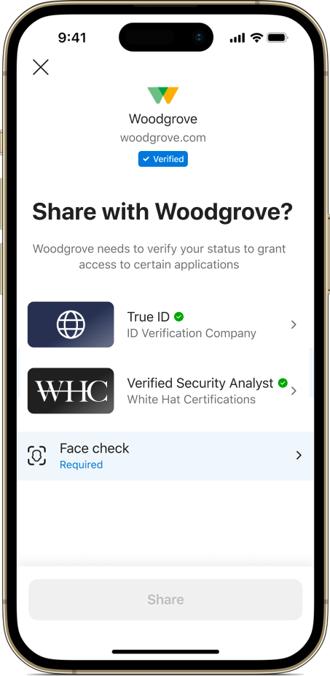
Intégration à distance en toute confiance
Check a user’s background or skills once, issue a reusable Verified ID
Check background with identity verification partners
Validate skills and certifications
Ensure the right person is gaining access to your organization
Ensure the right person onboards with Face Check
Eliminate excessive waiting and administrative work
Notes:
Onboarding new employees and ensuring that the new employee is who they claim to be is a challenge many customers are facing. Many customers are not properly verifying the identity of the new joiner during the hire process. Onboarding is also a process that can take days or weeks with background checks, administrative work, and other tedious tasks.
Using Microsoft Entra Verified ID, you can get your new talent on the job quickly and securely.
*Click for first check* Quickly check a user’s background with an IDV partner
*click for second check* validate their skills and certifications
*click for third check* and confirm who is onboarding with Face Check
Check a user’s background or skills once, issue a reusable Verified ID
When you use Verified ID for identity checks or professional licenses and credentials, workers only need to get certified once to receive a Verified ID that they can present as often as they need to prove their skills or identity. Examples: identity Verified ID from IDV partner, technical skills/training license (electrician, healthcare worker. Etc.)
This portability makes starting new jobs much less painful for gig workers, transfers, new hires. They can start their job after a quick check of their Verified IDs rather than having to wait for administrative work to process for sometimes days or weeks
Ensure the right person is gaining access to your organization
Two-way trust: Have full trust in who you are onboarding, and the new user be sure they’re giving their info to the right party
Check identity or certifications and verify user identities with Face Check before onboarding them by digitally validating information with industry leading ID verification providers.
By working with identity verification partners, organizations can easily integrate high quality identity verification into their current onboarding processes
Eliminate excessive waiting and administrative work
Create fast, easy, and cheap onboarding that doesn’t require new hires to spend time going through tedious in person verifications
Retire paper-based verification processes, digitize onboarding
Reduce time-to-hire and time-to-productivity with self-service remote enrollment
40% of HR workers cite onboarding as one of their biggest challenges, decreasing manual admin work for them will help lessen the challenge (https://www.g2.com/articles/onboarding-statistics)
TRANSITION: After a worker onboards, they will need access to apps and resources to do their jobs

Slide 28
Intégration à distance en toute confiance New employee onboarding
Step 1
Step 2
Step 3
New hire accepts job offer, company sends link to onboarding portal
New hire visits onboarding portal to request identity Verified ID from identity verification partner (IDV)
IDV validates the new hire’s identity and issues Verified ID to new hire
Extra steps:
Set up sign-in with phishing-resistant credentials
Step 5
Step 4
New hire’s identity is validated, company issues employee Verified ID and grants access for new hire to proceed with onboarding activities
Company requests that the new hire shares the identity Verified ID and completes Face Check
Notes:
Onboarding with Verified ID is simple, here’s an example for a newly hired worker:
After accepting the offer, the company invites the new hire to visit the onboarding portal.
Upon visiting the portal, the new hire is directed to an identity attestation process with an identity verification provider (IDV) chosen by the company. This was where in the demo, the employee filled in his name, took a picture, and submitted his government ID. The IDV used these elements to verify her identity.
The IDV validates the new hire’s identity and issues an identity Verified ID
The company requests that the new hire verify their identity by sharing the identity credential and completing a Face Check
After presenting the new Verified ID and sharing the result of the Face Check, the identity verification is complete, and the new hire can proceed with onboarding activities like getting an employee Verified ID
To take onboarding a step further, you can use Verified ID to set up passwordless sign-in with passkeys for added phishing resistance

Slide 29
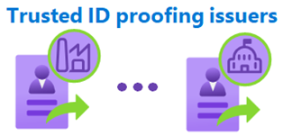




Intégration avec Verified ID et configuration de MIE résistants à l’hameçonnage
Return to scenarios
New employees
Skilled contractors
User
New employee, contractor, guest etc.
Step 1
User clicks on link from organization to start self-service onboarding
Verified ID onboarding flow
Step 2
Step 3
Step 4
Step 5
Identity verification (IDV) partner verifies the user’s identity & certifications
IDV issues Verified IDs to user that confirm identity & certifications
Organization has user present Verified IDs and complete Face Check to verify the user
User retrieves employee Verified ID, now has access to onboarding tasks (getting work device, accessing resources, etc.)
+
Step 8
Step 7
Step 6
User signs into account using phishing-resistant credential on their device
User uses TAP to acquire portable phishing-resistant credential
User presents employee Verified ID and completes Face Check to get temporary access pass (TAP)
OR
OR
OR
+
Passkey in Microsoft Authenticator
(iOS/Android)
Windows Hello for Business
macOS platform SSO
Passkey in
Microsoft Authenticator
Passkey in FIDO2 security key
Temporary access pass (TAP)
Notes:
Go through Verified Id normal onboarding flow.
After onboarding and getting an employee Verified ID, the Verified ID can be used to retrieve a temporary access pass, which is used to bootstrap phishing resistant credentials such as passkeys in Microsoft authenticator or a passkey in FIDO 2 security key

Slide 30

Accès sécurisé aux rôles et aux ressources sensibles

Slide 31
Problèmes d'accès courants
Risque de vol et d'usurpation d'identité
Défis en matière de conformité
Productivité perdue
1.5 million
75%
Over half
Credentials discoverable by attackers, detected by Microsoft
Global population’s personal data under privacy regulation by 2025
Of U.S. businesses struggle to grant employees access to critical resources
Microsoft Digital Defense Report 2024
Gartner 2024 Top Five Trends in Privacy
Nintex: Definitive guide to America’s most broken processes
Notes:
Microsoft found 1.5M credentials to be discoverable by attackers just between January and June 2024. Bad actors can take these credentials and use them to impersonate your employees, and steal resources, damage your organization, or plant malware
Example: Access to resources without verification creates risks: In 2023, an attacker got into a large telecom company through a single improperly secured API. Result was a data breach that affected approx. 37M customer accounts^{3,4}. Likely could have been avoided if they had proper ID verification before granting access
Regulation over data and access is growing: 75% of global population’s personal data will be under privacy regulation by year-end 2024² Imperative to know who has access to your resources and trust them, strict compliance requirements in place for regulated industries and government vendors. Hefty fines and penalties for noncompliance
FinServ: Know your customer (KYC) and anti-money laundering (AML) in the U.S.
Healthcare: patient privacy laws such as HIPPA in the U.S
Edu: student privacy protection laws such as FERPA in the U.S.
GDPR in Europe
Many companies use manual approvals to give their employees access to the right resources. This practice is slow, cumbersome, and limits productivity
TRANSITION: How can we add trust and efficiency to accessing internal resources?
--------------------------------------------------------------------------------------------
Sources
²Gartner 2024 Top Five Trends in Privacy: https://www.gartner.com/en/newsroom/press-releases/2022-05-31-gartner-identifies-top-five-trends-in-privacy-through-2024
³T-Mobile Informing Impacted Customers about Unauthorized Activity - T-Mobile Newsroom: https://www.t-mobile.com/news/business/customer-information
⁴T-Mobile breached by hackers as 37 million customers impacted - ABC News (go.com): https://abcnews.go.com/US/mobile-breached-hackers-37-million-customers-impacted/story?id=96557559

Slide 32
Secure access demo 1
Comment pouvez-vous être certain que vous donnez l'accès au bon utilisateur et non à quelqu'un qui se fait passer pour un professionnel en santé ou un membre du personnel en qui vous avez confiance ?
Notes:
Can you truly be 100% sure that the person you’re giving remote access to sensitive resources isn’t a convincing impersonation of your trusted employee?
TRANSITION: Let’s see how to improve this certainty using Verified ID

Slide 33
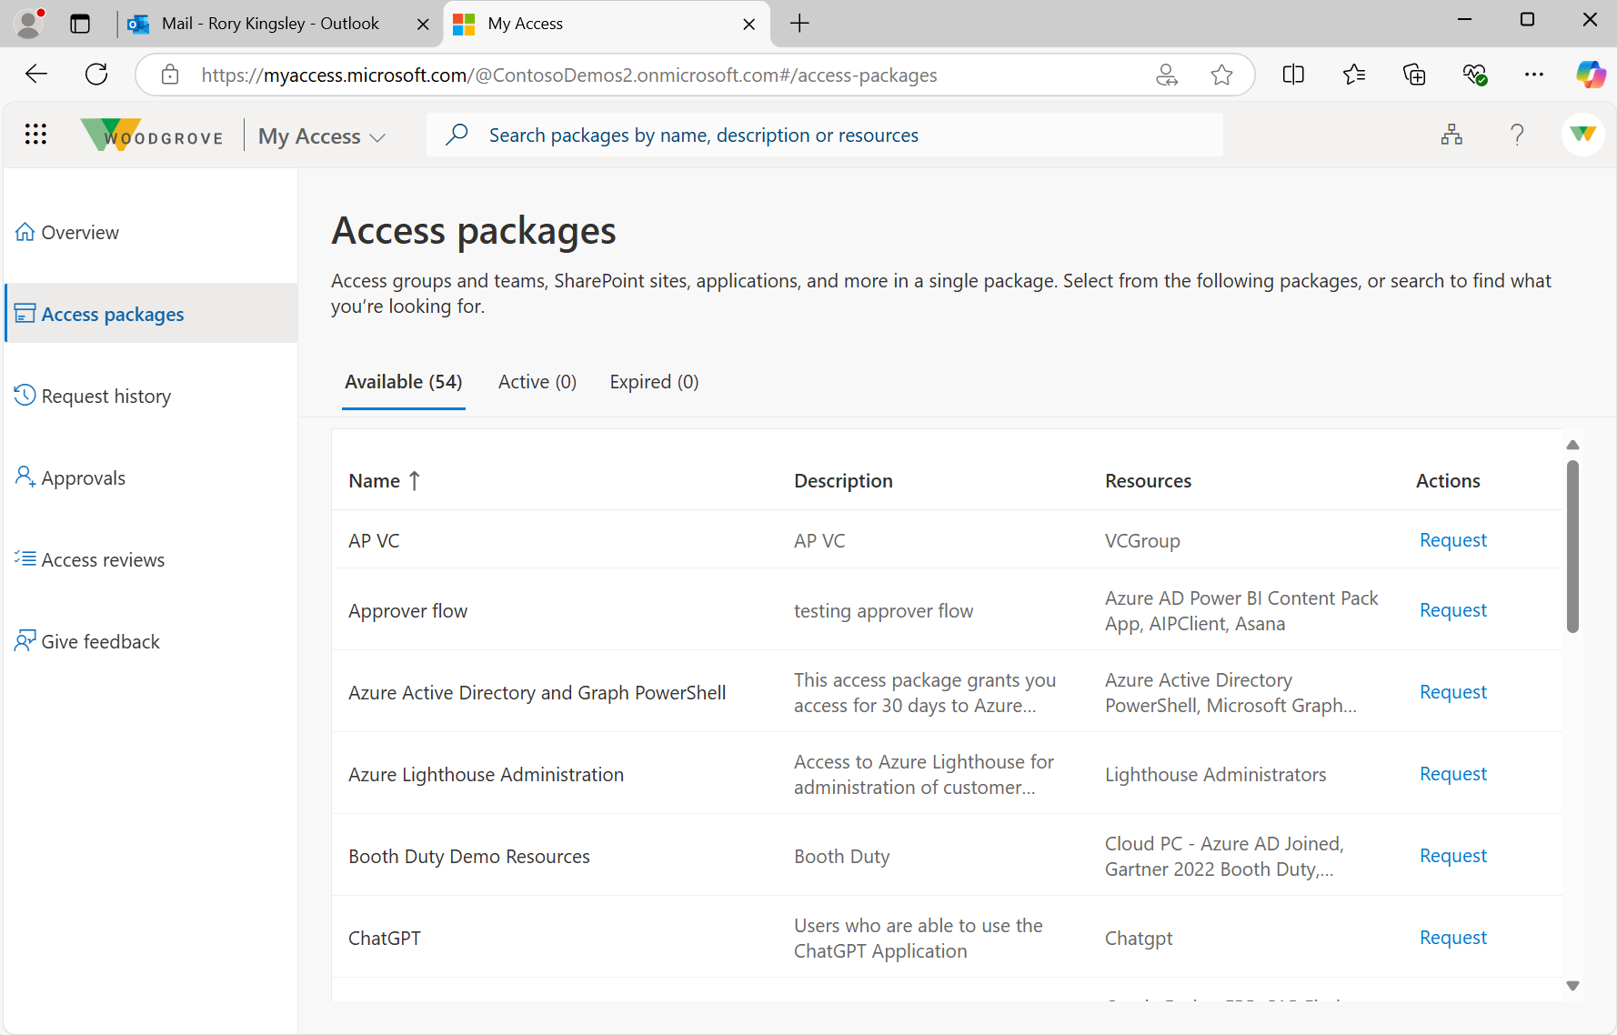

Accès sécurisé aux rôles et aux ressources sensibles with Entitlement Management in ID Governance
Access resources on MyAccess page
Manage access for employees, partners, guests, temporary workers, customers etc.
Reduce approval fatigue with automated access and revocation
Improve compliance posture
Verify identity and complete Face Check to access resources
Learn how Verified ID & ID Governance work together
Notes:
grant both employees and contractors (B2B guest users) access to the right resources at the right time to follow a Zero Trust model. This scenario uses both Verified ID and ID Governance with Entitlement Management, another Entra Suite product. Ensure that only the right employees and guests have access to sensitive resources and enable them to access those resources quickly and easily.
Manage access for all types of workers
This is not only something that can be useful for your own employees but also contractors, partners, guests, or any other external worker
Examples
To gain access to certain sensitive resources or roles, an employee might need to show his/her Verified ID that they completed the compliance training successfully, which gives them access to sensitive customer information for the next year.
For a contractor, you might want to have them present their Verified ID from their organization which proves that they work for that company and do a Face Check, before they gain access to a set of resources they need for collaboration
Reduce approval fatigue with automatic access and revocation
Workers and guests can request access to resources through an Access Package with entitlement management which is part of ID governance
Access Packages can be set so that only those with a certain Verified ID can access them. Examples of claims on these Verified IDs: certain training, clearance, certification, employment status, etc. Use Face Check to make sure the right person is accessing resources
Access Packages have automatic approvals, eliminating approval fatigue for managers and reducing the onboarding time for the employee or guest
Improve compliance posture by enabling least privilege access
When an employee leaves their job or a guest is done collaborating on a project, you can set it up to revoke their Verified ID automatically
Once the Verified ID is revoked, that individual’s access to the protected resource is automatically revoked.
Improve your compliance by knowing exactly who has access to what, and quickly revoke that access when the employee or guest no longer needs it.
TRANSITION: Eventually a worker may need to reset their account or access the help desk for another reason. How can you be sure that the right person is accessing the help desk?

Slide 34
Accès sécurisé aux ressources Guest access
Step 1
Step 2
Step 3
Organization needs to verify the identity of contractors or vendors before starting a project with them
The vendor must have verified employee credential from their employer to share with the verifying organization
The vendor requests access to the Access Package containing resources they will need to work with the organization
Step 5
Step 4
Vendor now has access to the protected resources in Access Package and can work with the organization on the project
Vendor presents verified employee credential and completes Face Check and then is automatically granted access to the Access Package
Notes:
Organization sends invitation for guest to have access to a privileged role or resource
Guest accepts invitation to begin verification process
Guest is asked to present Verified ID and complete Face Check to verify their identity before getting privileged access
Guest submits request for access to Access Package, employer portal automatically accepts
Guest now has access to Access Package and the protected resources it contains

Slide 35
Accès sécurisé aux ressources Employee training
Step 1
Step 2
Step 3
Organization requires yearly compliance training for employees with access to customer data
After completing the training, the employee receives a credential attesting the training’s completion
Employee requests access to the Access Package containing a work application. The app requires proof of training completion to use
Step 5
Step 4
Employee now has access to the protected application in the access package for the year
Employee completes a Face Check verification and presents compliance training credential and then is automatically accepted to work in the application
Notes:
An organization wants its employees to be current on compliance training before accessing customer data.
After an employee does their training, they receive a Verified ID attesting to the training’s completion.
Now the employee requests an Access Package that contains the resource the employee needs for their job.
After requesting the Access Package, the employee is presented with an identity challenge asking to prove their training before getting access.
The employee presents their training Verified ID and is given access to the resource
The employee now has access to the resource until it is time to complete the yearly training next year.

Slide 36
Accès sécurisé aux ressources Admin roles
Step 1
Step 2
Step 3
Organization requires identity verification for all who perform administration tasks before gaining access to sensitive data and resources
Employee goes to admin onboarding portal to verify identity with IDV partner. Partner issues credential confirming the employee’s identity
Employee goes to admin onboarding portal and presents identity credential and performs Face Check. Admin portal issues admin Verified ID after identity is verified
Step 5
Step 4
After verification, the employee now has access to the admin role and resources that come with it
To perform admin tasks, employee requests access to Access Package which contains the admin role. Access portal requests a Face Check and presentation of admin credential, which the employee completes
Notes:
Organization sends invitation for employee to have access to a privileged role or resource
Employee accepts invitation to begin verification process
Employee is asked to present Verified ID and complete Face Check to verify their identity before getting privileged access.
Employee submits request for admin permissions on admin onboarding portal. The admin onboarding portals responds with an identity challenge requiring the employee’s identity-confirming Verified
ID.
The employee presents their identity-confirming Verified ID to the admin onboarding portal, which then issues the employee a new admin Verified ID.
The employee now requests access to the Access Package containing the admin role. The access package responds with a challenge to ensure the employee is an admin. The employee presents their admin Verified ID to complete the verification.
Employee now has access to the protected resources

Slide 37
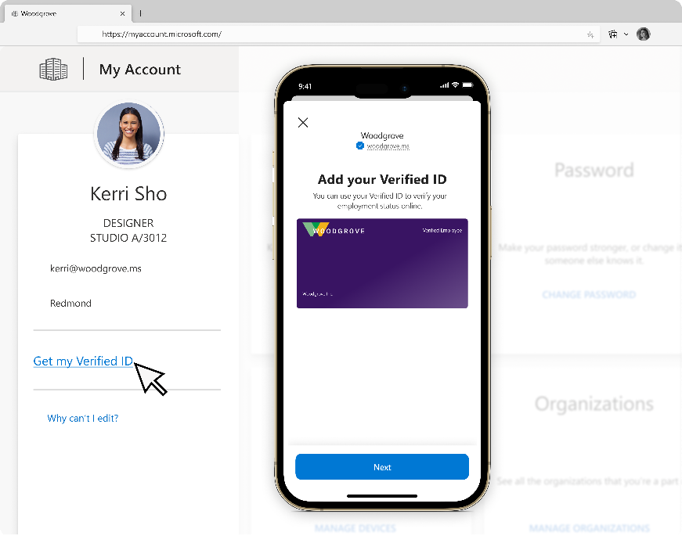











Accès sécurisé aux ressources with Entitlement Management in ID Governance
All automated using Microsoft Entra ID Governance
Step 1
Step 2
Step 3
Users
Users obtain Verified ID from My Account or Govt ID from a trusted authority
Users request access packages using My Access portal then share Verified ID & perform Face Check to verify identity
After a valid verification, users are automatically approved to access the access packages and can access privileged applications using active Microsoft Entra role assignments
Employees, contractors, business guests, etc.
Teams
sites
SharePoint Libraries
Admins
Users automatically lose access when access package assignment expires
Configure access packages
in Entitlement Management that contain Microsoft Entra roles and relevant applications
Return to
Secure Access Summary
Notes:
After a user onboards, they will need access to certain resources or apps. This flow shows how that access is automated with Entitlement Management in Microsoft Entra ID Governance

Slide 38

Support technique et récupération de comptes

Slide 39
Problèmes courants liés au service de support et à la récupération des comptes
Risque de dommages importants
Perte de temps pour les personnels
Vulnérabilités du service de support
$100 million
Over 3 hours
$1.1 billion
Damages from a single help desk-based attack
Average IT support ticket response time
Loses to impersonation scams in the U.S. in 2023
Inside The Ransomware Attack That Shut Down MGM Resorts - Forbes
A phone call to helpdesk was likely all it took to hack MGM - Ars Technica
How To Reduce Your Average Support Ticket Response Time | Databox
FTC Data Spotlight into impersonation scams
Notes:
Account recovery is expensive an inefficient. With simple and strong identity protection, help desk could be made cheaper, faster, and safer.
Help desk can be high risk for huge damages if it isn’t properly protected. Example: Happened to large entertainment company in 2023, impersonator had a 10 min call with the help desk, was given access to internal systems, and did damage forced MGM to shut down all systems and lost 100M in total. This was a result from an attack by a single cybercriminal group called “Scattered Spider”
Help desk should not take 3 hours to get a response, this delays results in wasted productivity for employees
impersonators often get in by posing as employees, calling the help desk, and getting their device registered to the employee’s account. They don’t need to steal an identity, they could convince an IT worker to let them in. In U.S. in 2023, over $1.1B loses to impersonation scams of all types and 330K+ reports of business impersonation scams⁸. 35% of business in the UK experienced an impersonation attack over the last 12 months^{9.}
Example: Happened to MGM in 2023, impersonator had a 10 min call with the help desk, was given access to MGM internal systems, and did damage forced MGM to shut down all systems and lost 100M in total^{7,10}
TRANSITION: How can we add trust to these interactions so that your organization knows who is on the other side of the screen?
----------------------------------------------------------------------------------------------------------------------------------------------------------
Sources
⁷Inside The Ransomware Attack That Shut Down MGM Resorts (forbes.com): https://www.forbes.com/sites/suzannerowankelleher/2023/09/13/ransomware-attack-mgm-resorts/
⁸Federal Trade Commission Research: https://www.ftc.gov/business-guidance/blog/2024/04/new-ftc-data-spotlight-offers-illuminating-insights-impersonation-scams
⁹uk.gov research: https://www.gov.uk/government/statistics/cyber-security-breaches-survey-2024/cyber-security-breaches-survey-2024
¹⁰MGM loses $100M, refused to pay ransom to end cyberattack (nypost.com) MGM loses $100M, refused to pay ransom to end cyberattack (nypost.com)

Slide 40
Help desk demo 1
Lorsque quelqu'un contacte votre service d'assistance, comment pouvez-vous être certain que l'utilisateur est légitime et qu'il ne se fait pas passer pour un personnel de confiance ?
Notes:
Can you truly be 100% sure that the person you’re giving remote help desk access to isn’t a convincing impersonation of your trusted employee?
TRANSITION: Let’s watch a demo to show how your organization could quickly and securely verify an employee before granting access

Slide 41
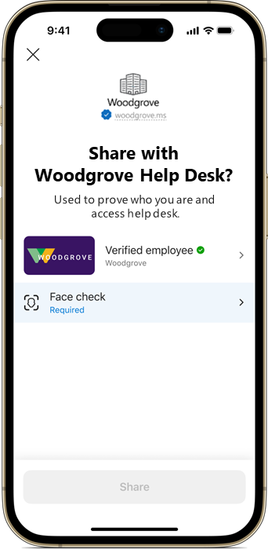
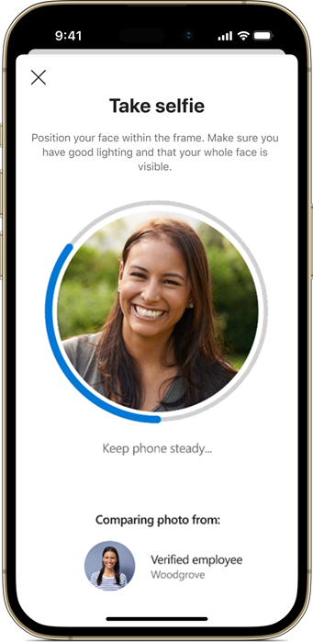
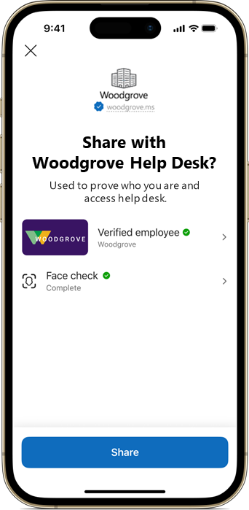
Support technique et récupération de comptes
Present Verified ID, start Face Check
Enable self-service help desk access
Increase trust in help desk operations
Take selfie for Face Check
Easily and securely recover account if locked out
User is verified to access help desk or recover account
Notes:
Replace support calls and security questions with a streamlined self-service help desk that verifies employment with Verified ID and uses Face Check to protect actions or accounts with higher sensitivities
Enable self-service help desk access
With a help desk powered by Verified ID, you can turn the help desk into a cheap, secure function for organizations with a streamlined experience for users.
Create a self-service route for basic help desk functions such as password reset and account recovery, drastically reduce the wait time for user and reduce approval fatigue for IT
The help desk agents can use their time for more complex requests rather than basic functions that can be done as self-service tasks. If there is a time sensitive helpdesk situation, users will be able to get their more difficult issues handled much more quickly
Increase trust in help desk operations
Trust goes both ways: organization can trust the identity of a user with a valid Verified ID, and users can trust that they aren’t in contact with someone impersonating the company help desk. Limit impersonation of individuals and companies.
add verifiability to your existing help desk to make it more efficient and cheaper to operate. There is no need to tear down what you already have.
no longer reliant on security questions that can be easily guessed to recovery someone’s account
Easily and securely recover account if locked out
Verify identity before giving access to account, combat impersonators who may use account recovery to gain access fraudulently
Only takes a few moments to recover account with valid credential
If a Verified ID is revoked, the holder will immediately no longer be able to access the help desk, so only the right verified employees will have access. This is very common, happens any time an employee leaves their job.
TRANSITION: Let’s take a closer look at these scenarios

Slide 42
Support technique vérifié
Step 1
Step 2
Step 3
Employee wants to change their password, edit their account settings, or access the helpdesk for another reason
Employee navigates to verified help desk which requires identity verification before allowing access
Help desk requests employee to present their employee Verified ID and complete Face Check
Step 5
Step 4
Help desk accepts valid Verified ID and Face Check result, employee now has access help desk
Employee presents valid Verified ID and completes Face Check to ensure liveness
Notes:
As shown in the demo, the scenario begins with an employee who wants to change their password or recover their account.
The employee will navigate to the self-service helpdesk and request access.
The help desk will challenge the employee and ask them to present a valid employee Verified ID and complete a Face Check
The employee presents the Verified ID and completes the Face Check and then has access to complete their helpdesk tasks

Slide 43
Récupération de comptes
Step 1
Step 2
Step 3
Employee has lost their work device and personal phone with their Verified IDs and needs to regain access to their account on a new device
On a new device, employee navigates to the organization’s sign-in page
Employee completes identity verification with IDV and receives a Verified ID affirming their identity
Step 5
Step 4
Organization accepts the employee's valid Verified and Face Check and now has access to regain their account
Organization requests that the employee present their Verified ID and complete a Face Check to prove who they are before regaining access to their account
Notes:
This flow is very similar to onboarding. The user has lost their device with verified ID and MFA, so they can’t sign in or access their account.
The user must reaffirm their identity with an IDV, just like onboarding.
The user gets an identity-confirming Verified ID from the IDV which they use to regain access to their account.
In many cases, user may have to set up MFA or passkeys on this new device

Slide 44
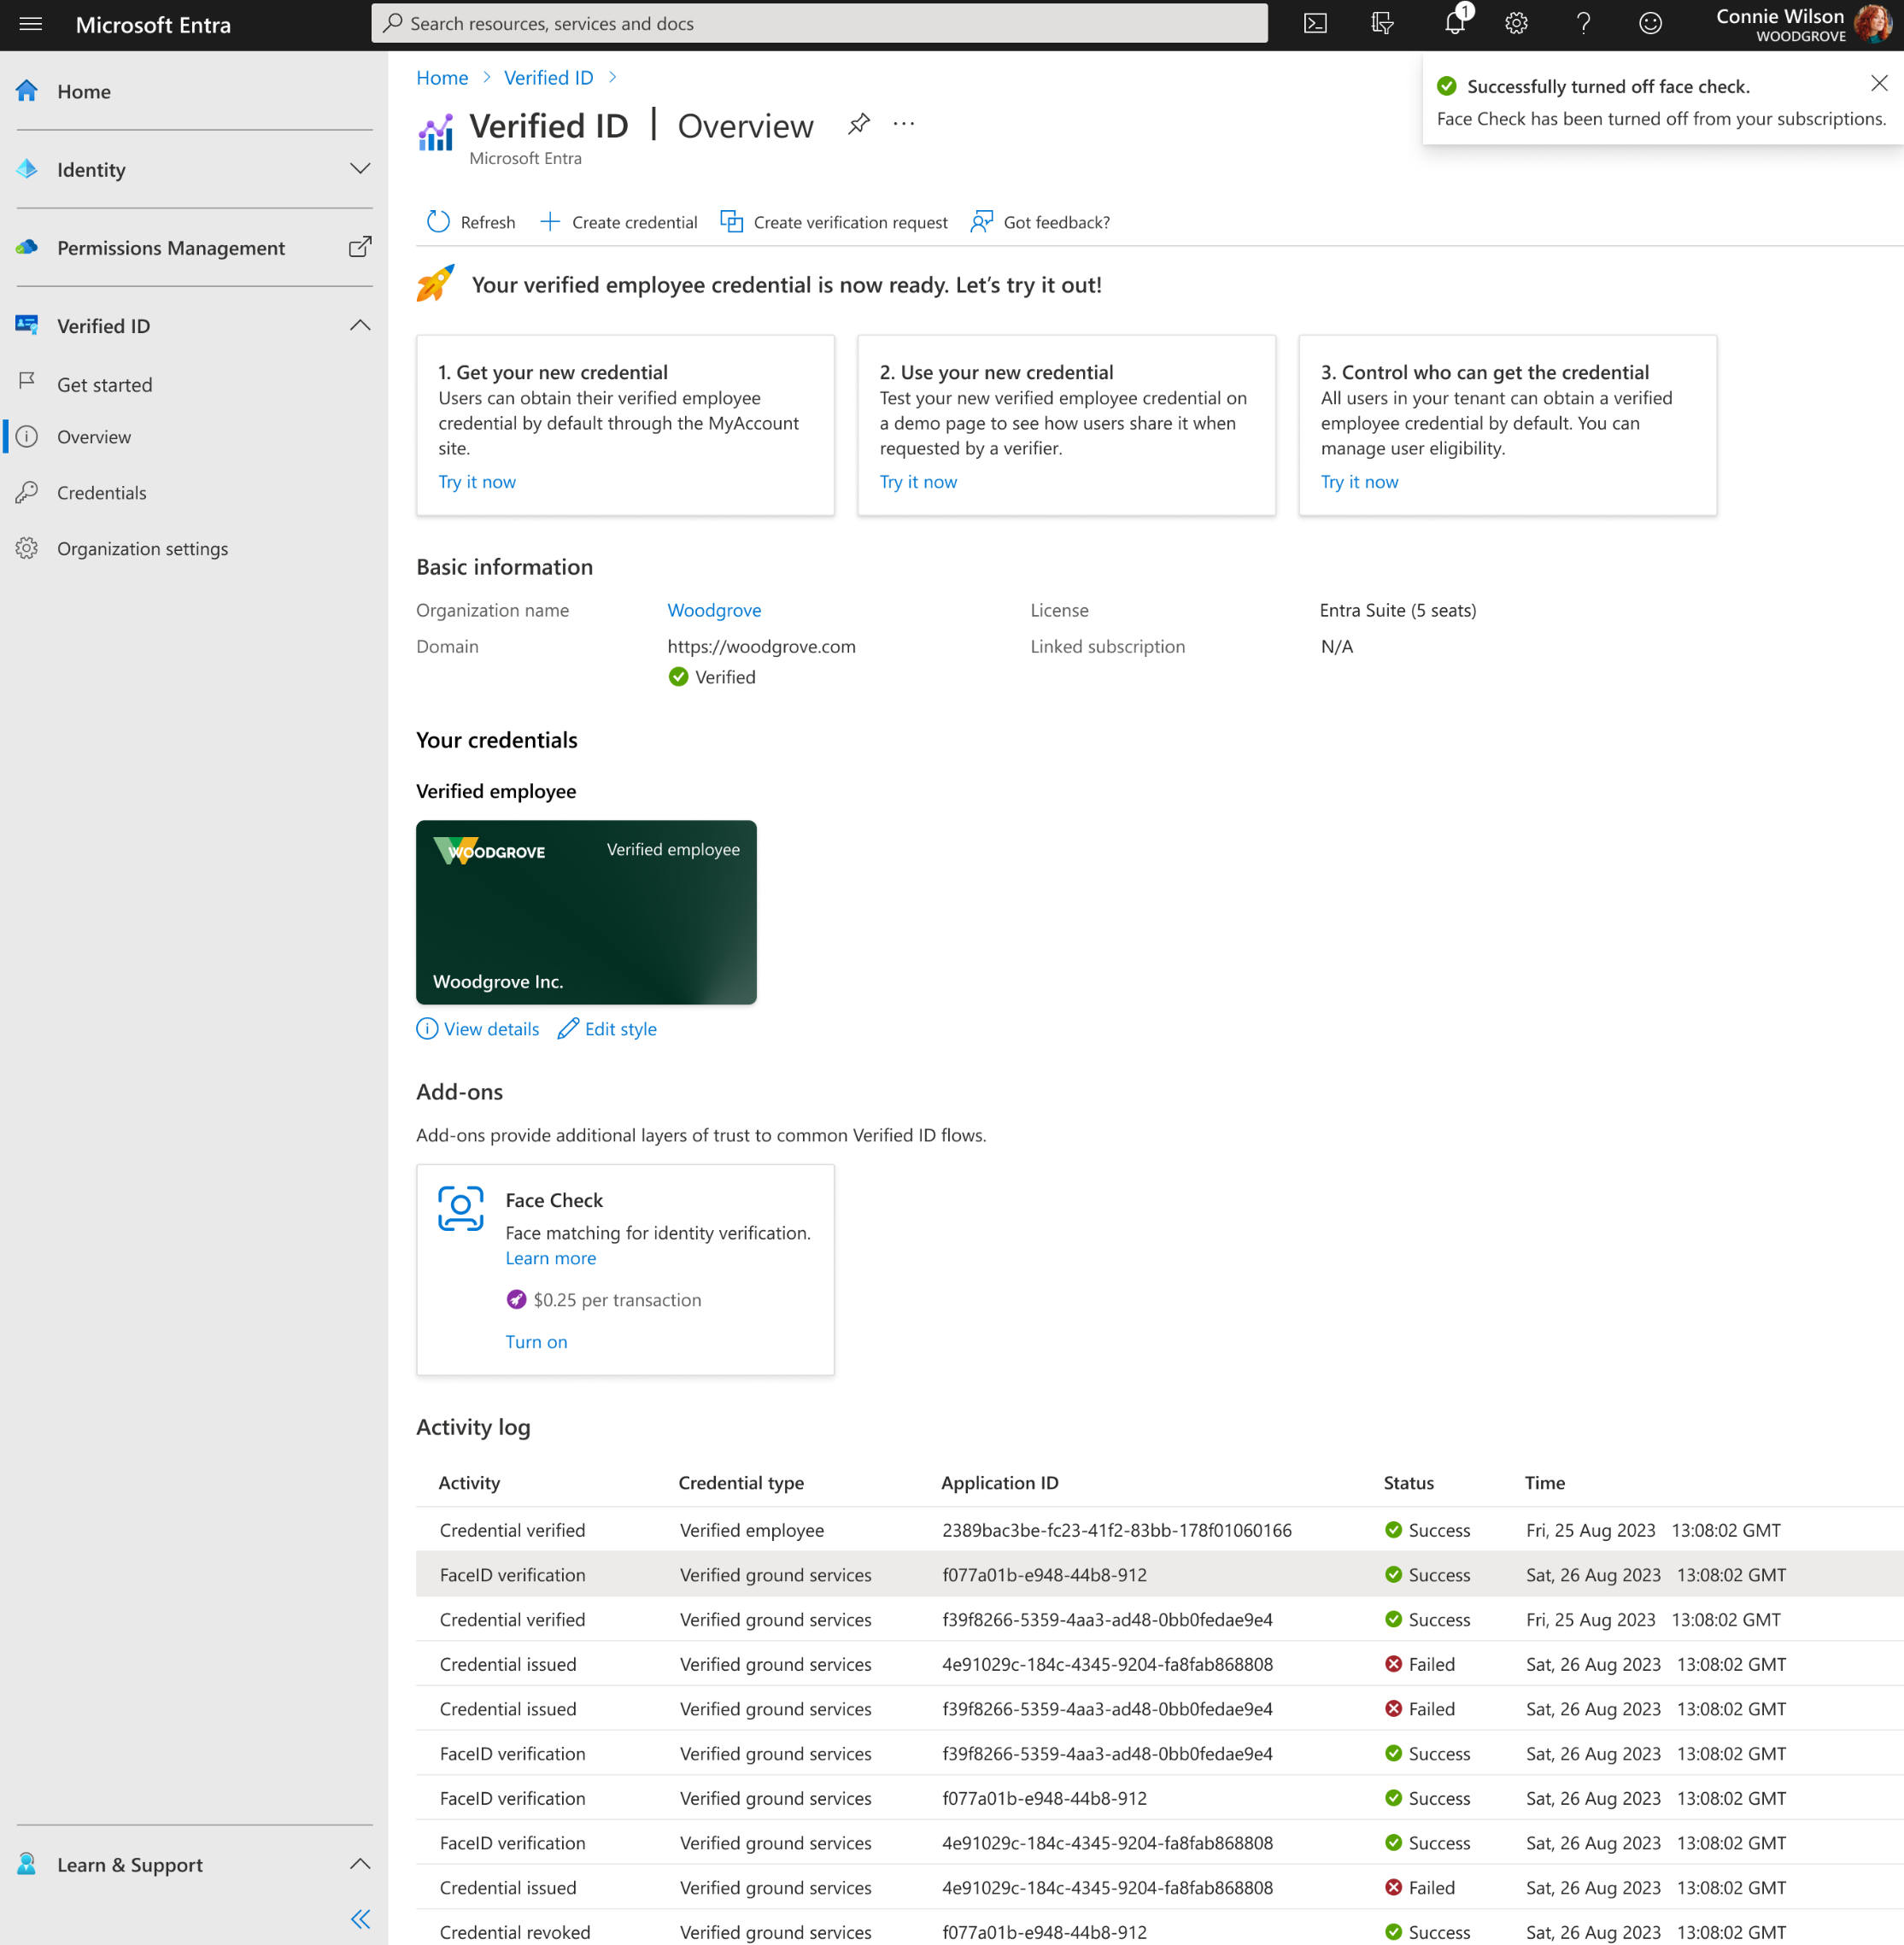
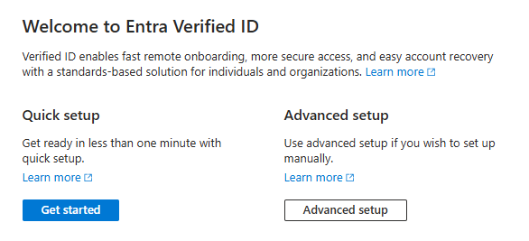

Protéger les comptes de confiance contre l'usurpation d'identité dès aujourd'hui
1
Obtenir votre locataire Entra Verified ID prêt à émettre et à vérifier en quelques minutes
2
Délivrer et vérifier immédiatement les identifiants vérifiés des PS et d’autres personnels pour les utilisateurs sélectionnés.
3
Activer Face Check* en un clic
* Tester Face Check gratuitement dans la version d'essai d'Entra Suite
Tutoriels et ressources pour démarrer
Notes:
You can set up Verified ID and get started in just a few minutes.
First follow the guided set up option that best fits your organization. *click to point 2*
After set up is complete, you can start issuing and verifying immediately. *click to point 3*
You can add Face Check to your service with an easy click
Follow tutorials for set up (links in resources). Once you’re set up and your first Verified ID is ready to use, you can enable Face Check with a single click. Either pay $0.25 or you can try for free with Entra Suite free trial
TRANSITION: These seems easy, what if you need help to get started with a specific type of verification or implementation?
There is another option for this slide in the appendix

Slide 45
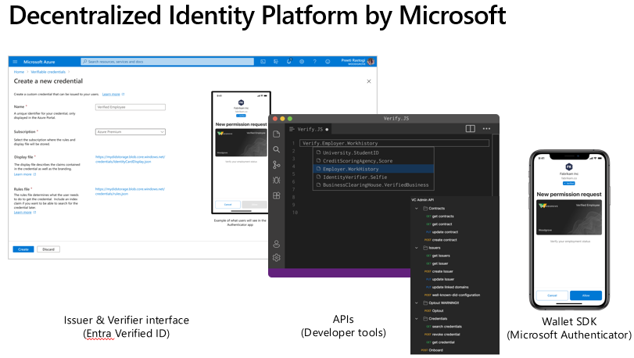
API Entra Verified ID
Request APIs (Client API) for issue and verify functions
Admin APIs to perform admin functions and add such functions to your own custom build control panels
Onboard
Credential contracts
Credential
Open-source library to integrate into branded app
Microsoft Entra Wallet Library
https://aka.ms/VerifiedIDdocs

Slide 46
Configuration rapide
Admin follows a simple single step process to enable Entra Verified ID setup
Requires the customer to be a M365 tenant with a custom domain (customerxxxx.onmicrosoft.com), as an Entra ID setting.
Global Administrator or the authentication policy administrator permission for the directory you want to configure. If you're not the Global Administrator, you need the application administrator permission to complete the app registration including granting admin consent.
Verified Employee credential template is configured as a part of the Verified ID service onboarding.
No requirement of setting up Azure Key Vault or hosting JSON files on the web servers

Slide 47
Configuration avancée
Prérequis
Global Admin or Authentication policy administrator. If you're not the Global Administrator, you need the application administrator permission to complete the app registration including granting admin consent.
Contributor role to Azure subscription/ Resource group where you are deploying Azure Key Vault instance
Access permissions on Azure KeyVault (Get, List, Sign key permissions)
Need a web endpoint that will be added to a service endpoint in your decentralized identity (DID) document. E.g. https://contoso.com. You will be hosting did.json and did-configuration.json files at the ./well-known path

Slide 48
Utilisation de la vérification faciale
Face Check Add-on can be enabled in two ways from the Microsoft Entra Admin Center or by using the Azure Resource Manager (ARM) Rest API via CLI
Pre-requisites
Associate or add an Azure subscription to your Microsoft Entra tenant
Make sure the user setting up Face Check has Contributor role for the Azure subscription
IMPORTANT :
If you're going to use Face Check in a tenant with the Microsoft Entra Suite license, Face Check is enabled at the tenant level, and the configuration applies to all authorities within that tenant.
For any other licenses (pay-as-you-go) you can enable Face Check individually by each authority on your tenant using the Azure Resource Manager (ARM) Rest API.

Slide 49
Installation de Face Check
az rest --method PUT --uri /subscriptions/<subscription-id>/resourceGroups/<resource-group-name>/providers/Microsoft.VerifiedId/authorities/{authority-id}?api-version=2024-01-26-preview --body "{'location':'northeurope'}"
Replace <subscription-id> with your subscription id
Replace <resource-group-name> with your resource group name
Replace <authority-id> with your authority ID. You can obtain the authority-id using the GET Authorities call from the Admin API.
Replace <rp-location> using one of the following two values:
For EU tenants, use northeurope
az provider show -n Microsoft.VerifiedId
If you have enabled add-on from UI from the first authority, you could check the Verified ID provider by executing
Notes:
To set up the Face Check Add-on on a given authority, you must have the Azure PowerShell tools in your machine. The below mechanism wraps the REST call. You can alternatively use the Azure Resource Manager (ARM) Rest API PUT accordinglyStep1 – If you have enabled add-on from UI from the first authority, you could check the Verified ID provider by executing
az provider show -n Microsoft.VerifiedId
Step2 – (please note - az cli is just wrapping the REST call and handling auth. If you would like to use ARM APIs differently, then you can do the REST API PUT accordingly.)
az rest --method PUT --uri /subscriptions/<subscription-id>/resourceGroups/<resource-group-name>/providers/Microsoft.VerifiedId/authorities/{authority-id}?api-version=2024-01-26-preview --body "{'location':' westus2'}" –verbose

Slide 50
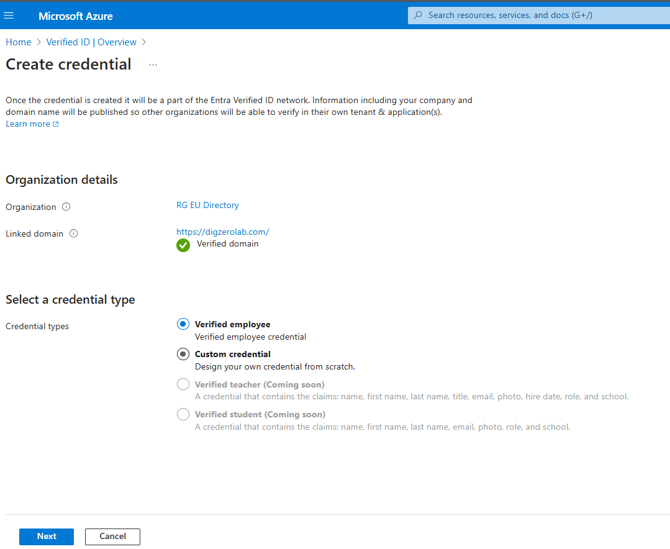
Démarrage rapide pour les revendications basées sur l'annuaire
Effortlessly create a credential where the claims come from a user profile in the directory of the Entra ID tenant
Please note: VerifiedEmployee is created by default for Quick Setup

Slide 51
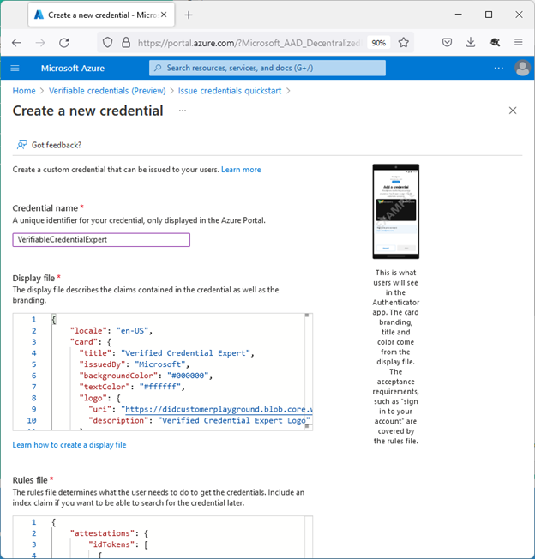
Démarrage rapide pour les revendications personnalisées
When using the QuickStart, just enter all details in the Azure portal and create a custom credential on a single page

Slide 52
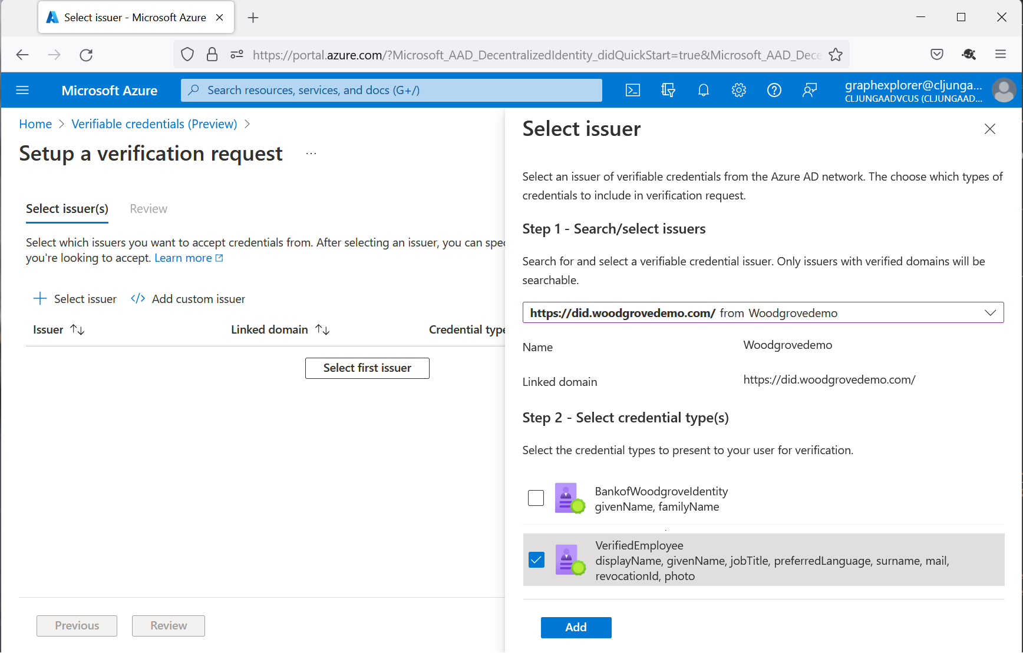
Réseau Microsoft Entra Verified ID
Vérifier des crédentités à l'aide du réseau Microsoft Entra Verified ID
Search for published credential types and schemas in the Entra Verified ID Network to easily generate a presentation request

Slide 53
Arbre de décision pour les types de crédentités
Credential Types
Managed Credentials
Verified Employee
Verified Student
Custom Credentials
Idtoken
Verified Teacher
Idtoken_hint
Self Attested
Presentation attestation
Multiple attestations
Developers can bring in different attestation patterns via JSON files for Display and Rules
Templates that use Microsoft Graph
Coming soon
Coming soon
Supports any OpenID connect provider flows
Supports claim injection where the relying party application passes claim values in the issuance request payload.
Supports claim injection where user is required to manually enter values for the claims in Microsoft Authenticator
Supports claim injection where user presents a verifiable credential during issuance and claim values for issuance of the new credential are taken from the presented credential.
Supports claim injection where claims come from more than one source.
e.g. – Idtoken
+ self-attested

Slide 54

Tutoriels pour la mise en place de cas d'utilisation clés
Intégration à distance
Support technique vérifié
Accès sécurisé
Notes:
Liens:
Intégrer de nouveaux employés distants à l’aide de la vérification d’ID - Microsoft Entra Verified ID | Microsoft Learn: https://learn.microsoft.com/fr-fr/entra/verified-id/remote-onboarding-new-employees-id-verification
Support technique vérifié avec Vérification d’identité Microsoft Entra - Microsoft Entra Verified ID | Microsoft Learn: https://learn.microsoft.com/fr-fr/entra/verified-id/helpdesk-with-verified-id
Configurez les paramètres d’identifiant vérifié d’un package d’accès dans la fonctionnalité de gestion des droits d’utilisation - Microsoft Entra ID Governance | Microsoft Learn: https://learn.microsoft.com/fr-fr/entra/id-governance/entitlement-management-verified-id-settings

Slide 55
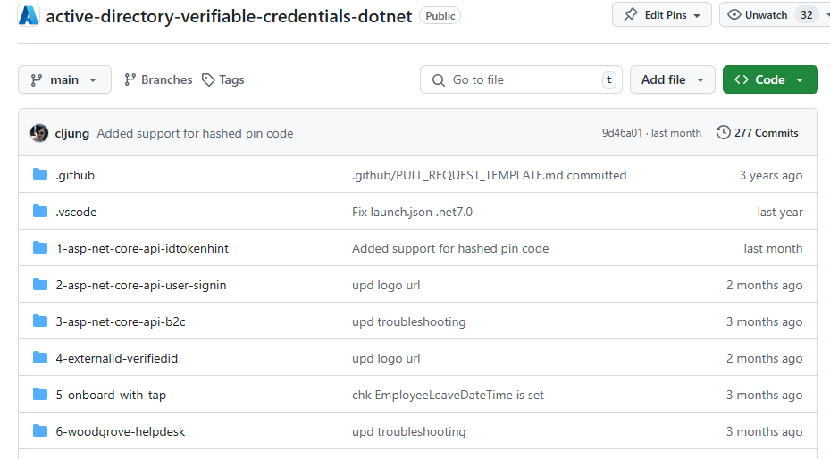
Documentation et exemples de code
Documentation : https://aka.ms/didfordevs
Exemples de code : https://aka.ms/vcsample

Slide 56
Annexes

Slide 57
Vos scénarios sous forme de « Storyboards »
Comment vérifiez-vous aujourd'hui l'identité de vos professionnels en santé, des autres utilisateurs, de vos prestataires et des patients ?
Combien de temps faut-il pour vérifier l'identité d'un utilisateur ?
Y a-t-il des cas où vous n'êtes pas sûr à 100 % de l'identité de l'interlocuteur lors d'une interaction numérique ?
Pour quels scénarios avez-vous besoin d'une vérification d'identité à haut niveau d'assurance ?
Comment garantissez-vous la confidentialité des données pour vos professionnels en santé, des autres utilisateurs, de vos prestataires et des patients ?
Comment protégez-vous votre établissement contre les attaques par usurpation d'identité ?
Notes:
Identity verification is becoming more important as work and life shifts more online. Digital identities are how people interact with the world today, both in work and personal life. Hackers understand this and are looking to take advantage of it by targeting identity more frequently and with more advanced methods such as deepfakes and other forms of impersonation powered by generative AI. Analysts understand these shifts and are giving us warnings.
TRANSITION: What are some specific areas where identify verification is especially needed?

Slide 58

Health Records - Issuing Card
To
From
Subject
Alice Smith
someone
Keeping and presenting your health records is a scan away
Healthcare Provider Portal
Authenticator
Obtain your health records powered by OneDID by scanning this QR code in Authenticator
Welcome to CA Healthcare Provider
We partner with OneDID so you can now obtain a Verified OneDID card containing your health records directly onto your phone. Use your card in more than 20,000 medical institutions nation wide.
.
Add to Authenticator
Username
Password
Get card
Sign in
Email
OneDID Agent Portal
Authenticator sign in
Authenticator
Authenticator
Authenticator
Alice Health Records
CA Healthcare Provider
Issued by OneDID
Information in this card
Alice Health Records
Card Receipts
Activity on this card
First: Alice
Allergies: none
Date: 01.01.21 – card issued
Last: Smith
Hearth conditions: none
Where can I use this?
Sign in to applications outside your company.
DOB: xx/xx/xxxx
Gender: F
Smokes: No
Blood Type: A+
Drinks: No
Height 5’9
Weight: xx.xk
Add card
Close
Close
Accept a card
Card details
Card receipts

Slide 59



Health Records - Presenting and Verifying Card
intranet.floridahealthcare.net
Authenticator
Florida Healthcare Provider Intranet
Patient Registration
Card Status: valid
Provider OneDID/CA Healthcare
To access your health records for faster patience registrations
Patient registration
OneDID
Patient Details
Additional FL patient details
Alice Health Records
Healthcare Provider
Issued by OneDID
First: Alice
Allergies: none
Type of service: Emergency
Last: Smith
Hearth conditions: none
Status: ER Triage
DOB: xx/xx/xxxx
Florida Healthcare Provider Office
Gender: F
Smokes: No
Blood Type: A+
Drinks: No
Accept and Present
Height 5’9
Weight: xx.xk
Register Patient
Healthcare facility registration
Present Health records card
Patient registration at institution
intranet.floridahealthcare.net
To
From
Subject
Alice Smith
CA Healthcare providers
Provider visit
Florida Healthcare Internal System
Authenticator
Patient Details
Diagnostic
Card Receipts
First: Alice
Allergies: none
Procedure one: Hand inspection
Our records indicate that you visited Florida Healthcare provider on 02.01.21. You can access the records of your visit in our portal
.
Activity on this card
Last: Smith
Hearth conditions: none
Procedure two: x-ray right hand
Date: 01.01.21 – card issued
DOB: xx/xx/xxxx
Procedure two: x-ray right hand
Gender: F
Smokes: No
Date: 02.01.21 – Presented at FL healthcare provider
Blood Type: A+
Drinks: No
Go to Portal
Date: 02.01.21 – Healthcare records updated
Height 5’9
Treatment
Weight: xx.xk
Immobilization of finger follow up in 1-week
Patience Status: valid, active with
provider
Cost $xx,xxx.xx
Provider: CA Healthcare provider
File Claim
Close
Healthcare service details claims
Transaction notification
Alice VC card receipt

